Slide 1
Housing Market Project Overview
DSC680-T301 Applied Data Science
By: Joshua Greenert
4/1/2023
Notes:
Good afternoon/evening, and welcome to my presentation over the housing market.

Slide 2

Business Problem
We will attempt to discover whether homeowners should be considering selling their investments, whether their homes will be massively underwater, and whether the housing market will remain stable for existing and new investors.
Notes:
Whether you’re a current homeowner, a potential future buyer, or someone who has an interest in investing, you typically want to know that your foundation is solid before moving forward with such a massive investment. With the pandemonium that took place during the 2008 housing crisis, this fear is certainly understandable. The goal of this project, therefore, was to understand the layout of the current housing market, analyze previous data points, and estimate the potential flow of future data points.

Slide 3
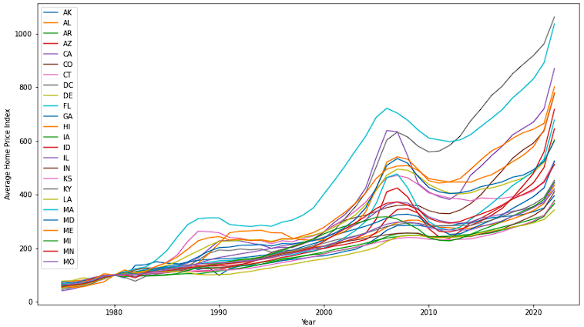
Visualizations (HPI)
Notes:
As part of the data prep process, I typically like to graph my data to see what I’m working with. Here we see the US Home Price Index grouped by state by year. This allows us to see major events that occurred and determine whether the data is all-encompassing. For instance, we can clearly see the 2008 recession, and the subsequent rise over the following years.

Slide 4
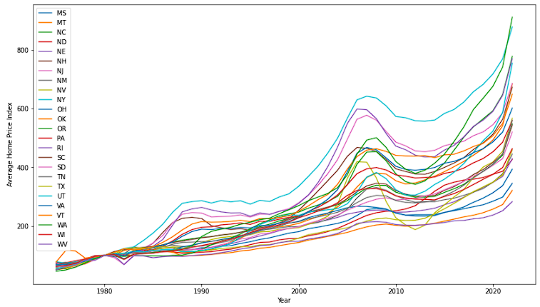
Visualizations (HPI 2)
Notes:
Since 50 states is a large number, I split the data into two graphs to be easily consumed. Another major point we see from these graphs is that some states are clearly more volatile than others.

Slide 5
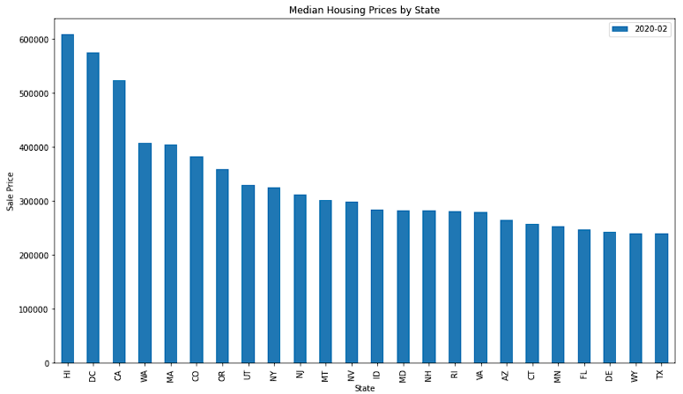
Visualizations (Zillow)
Notes:
To compare the prices for the previous data points, I pulled in a zillow dataset while cutting out the highest year with full data for each state to determine the median house price by state. Immediately, we can see that the data for Hawaii and DC agree with our previous data, and with the timeline for 2020.

Slide 6
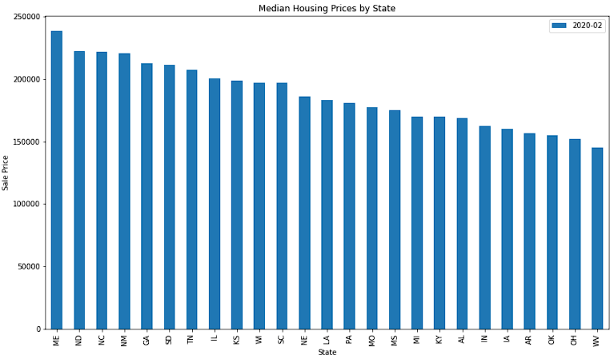
Visualizations (Zillow 2)
Notes:
Likewise, we can see that states like West Virginia and Ohio rank towards the bottom of the graph. These states, and states similar to these, have low volatility and seem to have a reasonable price point based on location and popularity.

Slide 7

Methods
Random Forest Regression (RFR)
Linear Regression (LR)
Autoregressive Integrated Moving Average (ARIMA)
Notes:
While RFR and LR didn’t appear to be the best to use with the datasets I found, I still wanted to test their efficiency at making predictions. According to the accuracy metrics, the closest between the two was LInear Regression with the ability to predict the average price with $100,000 worth of error (meaning that the data could be up or down $100,000), making it a useless prediction. The ARIMA model, however, was fairly accurate when coupled with the HPI dataset.

Slide 8
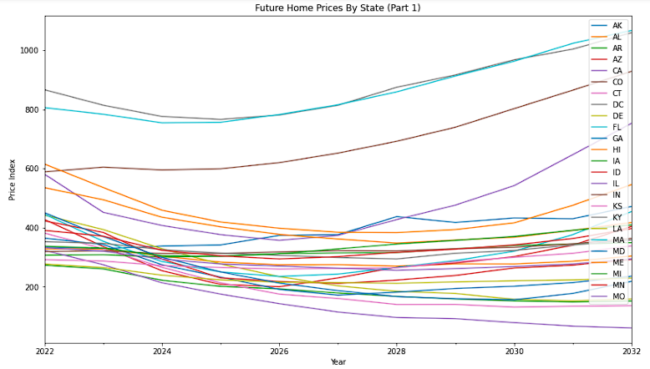
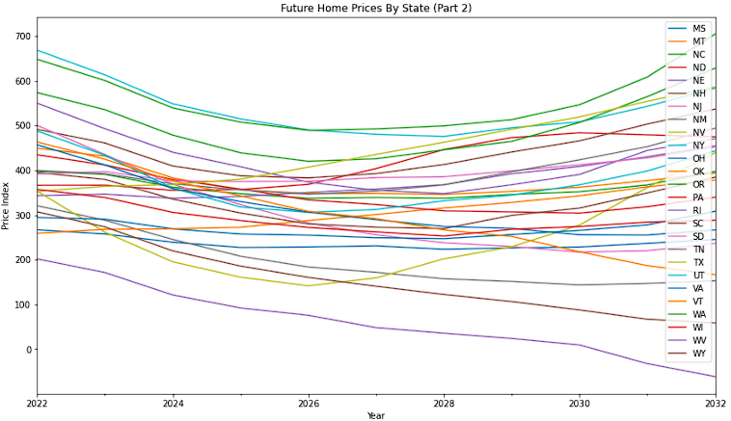
Analysis
Notes:
The visualizations above show the predictions made by the ARIMA model by state by year. While there are some states that don’t follow any typical convention (such as WV, WY, and MO), there are several more that outline our initial assumption when looking at the previous graphs of the HPI data. States with higher volatility continue to have high volatility (i.e. they are more likely to have major increases and decreases in their respective value) while states with low to medium volatility seem to carry almost no impact at all except for a gradual dip, then recovery.

Slide 9
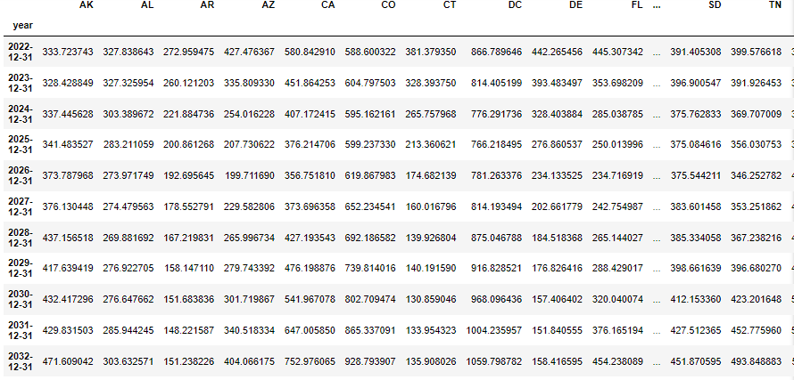
Interpretation of Results
Notes:
The difficult thing about predictions is that there are far too many variables to consider them foolproof, or one-hundred percent accurate. They are estimations based on the current data provided within the scopes defined. This model is far from perfect, but does provide consistent expectations for future HPI values that can be measured, and the model can be improved with further development and insight to hone in on the current market trends. As an investor or homeowner, making a financial decision should be based on several factors and, as we’ve seen from the data, be based on the current understanding of your respective state’s volatility to make the most optimal business decision for you and your family.

Slide 10

Ethical Assessment
Not Financial Advice
Openly Sourced Data
Notes:
The most imperative ethical consideration here is that this is by no means financial advice. Please seek guidance with a fiduciary or trusted mortgage lender to make long-term financial decisions with while performing the necessary research. All data covered within this presentation is based on open-sourced datasets that are linked in the references on the final slide.

Slide 11
Questions Asked By Audience
How accurate are these models/predictions?
Why would you use an ARIMA model over LSTM models?
Why would Zillow data be accurate in regards to current average pricing?
Who benefits from seeing these predictions more?
Will these predictions, when positive, make housing prices rise or vice versa?
Why would SPY be a significant indicator that the results of this data would be impacted?
Why would certain regions within each state be possible to not meet the predictions?
Could these predictions help to estimate the possibility of future stock market crashes?
Does this mean that people should expect a recovery time period of about four years for each time we see a massive dip in the housing market?
What are some steps the country can take to avoid potential crashes in the future?
Notes:
How accurate are these models/predictions?
These model and predictions are based on the current data provided by the the Federal Housing Finance Agency. Based on the prices listed from Zillow for purchase-only sold locations in 2022, the data for most states appear within the median range provided.
Why would you use an ARIMA model over LSTM models?
A Long Short-Term Memory (LSTM) model was attempted, but the results were far worse with the predictions than the ARIMA model as the values were expected to only go up with all states. If this were a wallstreetbets subreddit, i'd have used that instead.
Why would Zillow data be accurate in regards to current average pricing?
Zillow is one of the largest sites used to view and purchase homes in the US. The collected through that medium would include outliers while also including a significant amount of prices that homes actually sold for.
Who benefits from seeing these predictions more?
Any investor benefits from seeing these predictions and their expected results. A savvy investor who can utilize all of the tools within their arsenal is setting themselves up for a proper amount of skepticism.
Will these predictions, when positive, make housing prices rise or vice versa?
It's unlikely that these predictions will affect housing market prices, especially since the current model has some errors. In all actuallity, these predictions shouldn't impact the price of homes, but assist to confirm people's interest in buying them.
Why would SPY be a significant indicator that the results of this data would be impacted?
SPY (or the S & P 500) is a mass-collection of stocks within the hospitality, technology, and healthcare industry. If SPY were to dip significantly downward, it could lead to a domino effect of margin calls and forced-selling within the housing market industry.
Why would certain regions within each state be possible to not meet the predictions?
Certain regions may be more prominent than others within the state. For instance homes outside of Louisville Kentucky may not cost nearly as much as homes within Louisville due to their proximity to downtown areas, resources, etc.
Could these predictions help to estimate the possibility of future stock market crashes?
It's possible that these predictions may assist in seeing future curves within the housing market, which may indicate a dip within the stock market, but that's completely speculation and unlikely.
Does this mean that people should expect a recovery time period of about four years for each time we see a massive dip in the housing market?
There are no hard and fast rules about financial recovery. Any amount of time stated or shown throughout this project is not financial advice, nor is it guidance on when would be the best time to sell investments. Please use caution when making any major financial decisions and consult a financial expert.
What are some steps the country can take to avoid potential crashes in the future?
That's tough to say. The reason they rise, in most cases, is due to demand and people willing to pay the price that others are offering their home for. Would it make sense for the government to set a limit on a capitalistic society? I certainly don't think so, but the government is the one hosting this data, and they can show a view similar to the ones that I have to provide more insight to investors.

Slide 12
References
Federal Housing Finance Agency. (2022). House Price Index Datasets [Data set]. Retrieved from https://www.fhfa.gov/DataTools/Downloads/Pages/House-Price-Index-Datasets.aspx
Mooney, P. T. (2021). Zillow House Price Data [Data set]. Kaggle. https://www.kaggle.com/datasets/paultimothymooney/zillow-house-price-data?select=Sale_Prices_State.csv
Parker, K., & Stepler, R. (2021, August 2). As national eviction ban expires, a look at who rents and who owns in the U.S. Pew Research Center. https://www.pewresearch.org/fact-tank/2021/08/02/as-national-eviction-ban-expires-a-look-at-who-rents-and-who-owns-in-the-u-s/
Yasser, H. (2020). Housing Prices Dataset. Kaggle. Retrieved February 14, 2023, from https://www.kaggle.com/datasets/yasserh/housing-prices-dataset
Notes:
Thank you for coming! Here are the references for your own personal reviewing considerations.

